Slide 1

Introduction to FIJI
Huw Naylor

Slide 2
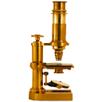

What are ImageJ and FIJI?
ImageJ is a Java-based, graphic user interface-based, image analysis package
FIJI (“FIJI is just ImageJ”) is a widely-use distribution of ImageJ that comes pre-packaged with a useful set of additional plugins.
Free, open-source software.
Popular platforms, both for users, and developers who create new plugins for specific purposes.

Slide 3
Background 1: What is an image?
The Golden Rule of image analysis:
Your pixel values ARE your data.
Guard them with your life.

Slide 4
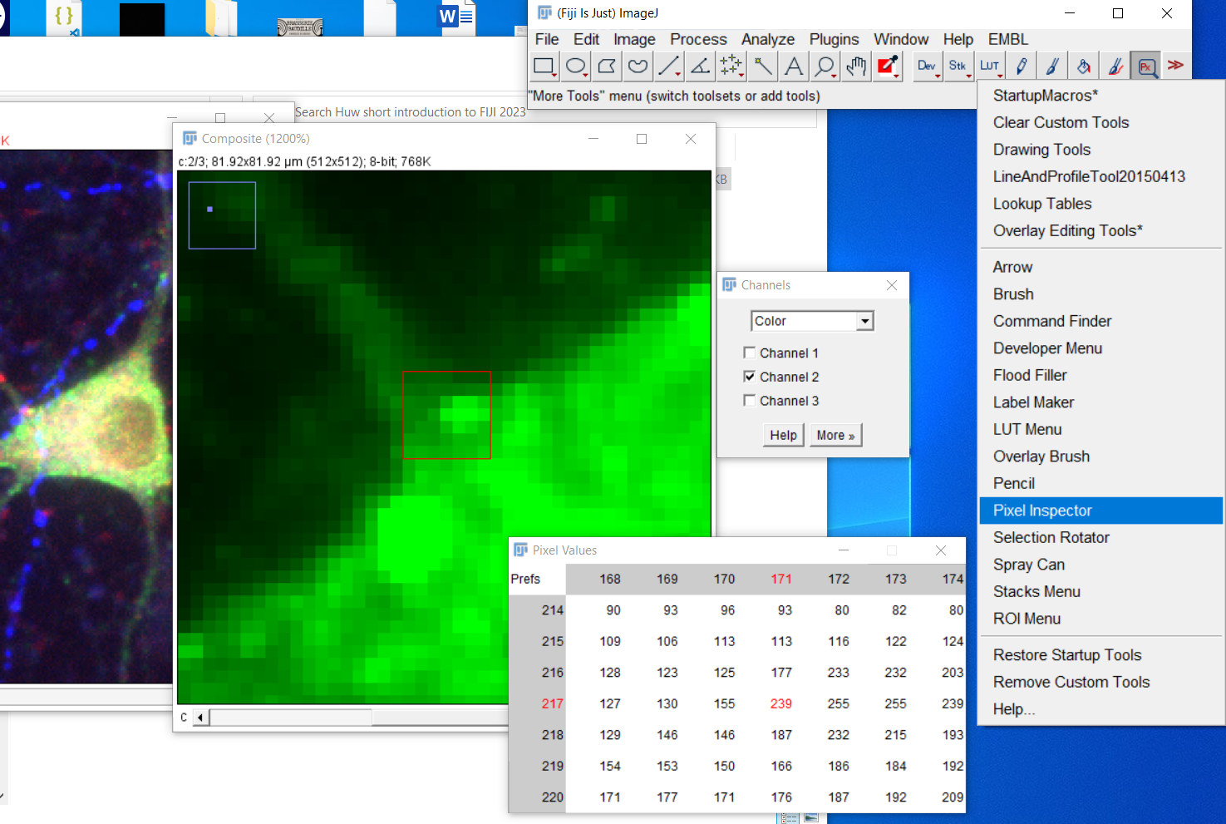
Background 2: Thinking in pixel values in FIJI

Slide 5
Background 1b: Types of images and bitdepth
2⁸ = 256, so values 0-255
2¹⁶ = 65536, so values 0-65535

Slide 6
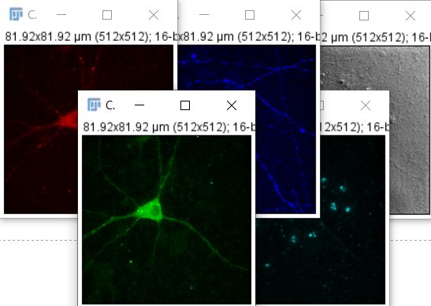
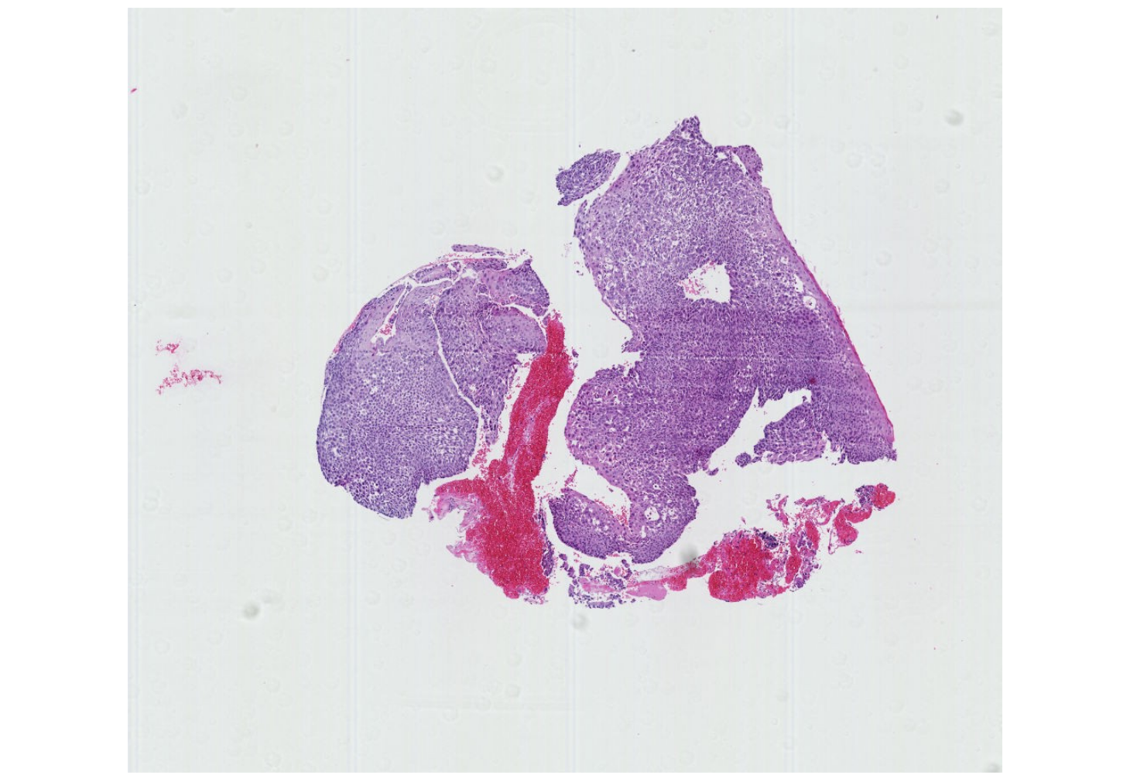
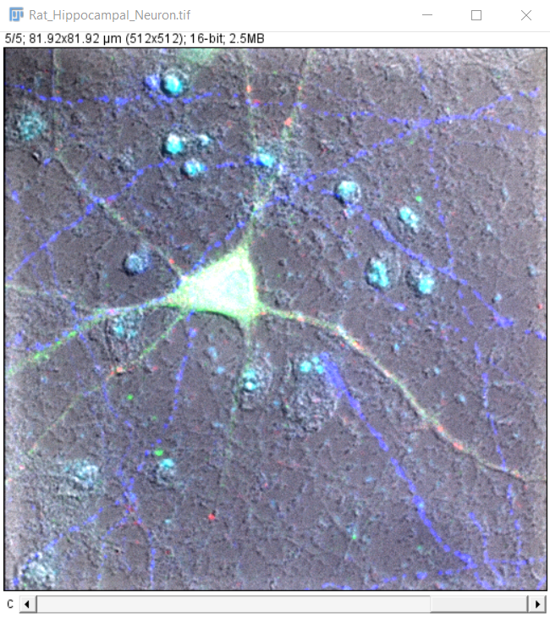
Typical examples:
Pennycuick A et al 2020
https://doi.org/10.1158/2159-8290.CD-19-1366
IDR 9846228
Pathology slide image:
Chromogenic staining
Colour camera -> RGB images
Microscopic IF image:
Fluorescence staining
Monochrome camera -> 16-bit or 8-bit images, one per channel

Slide 7
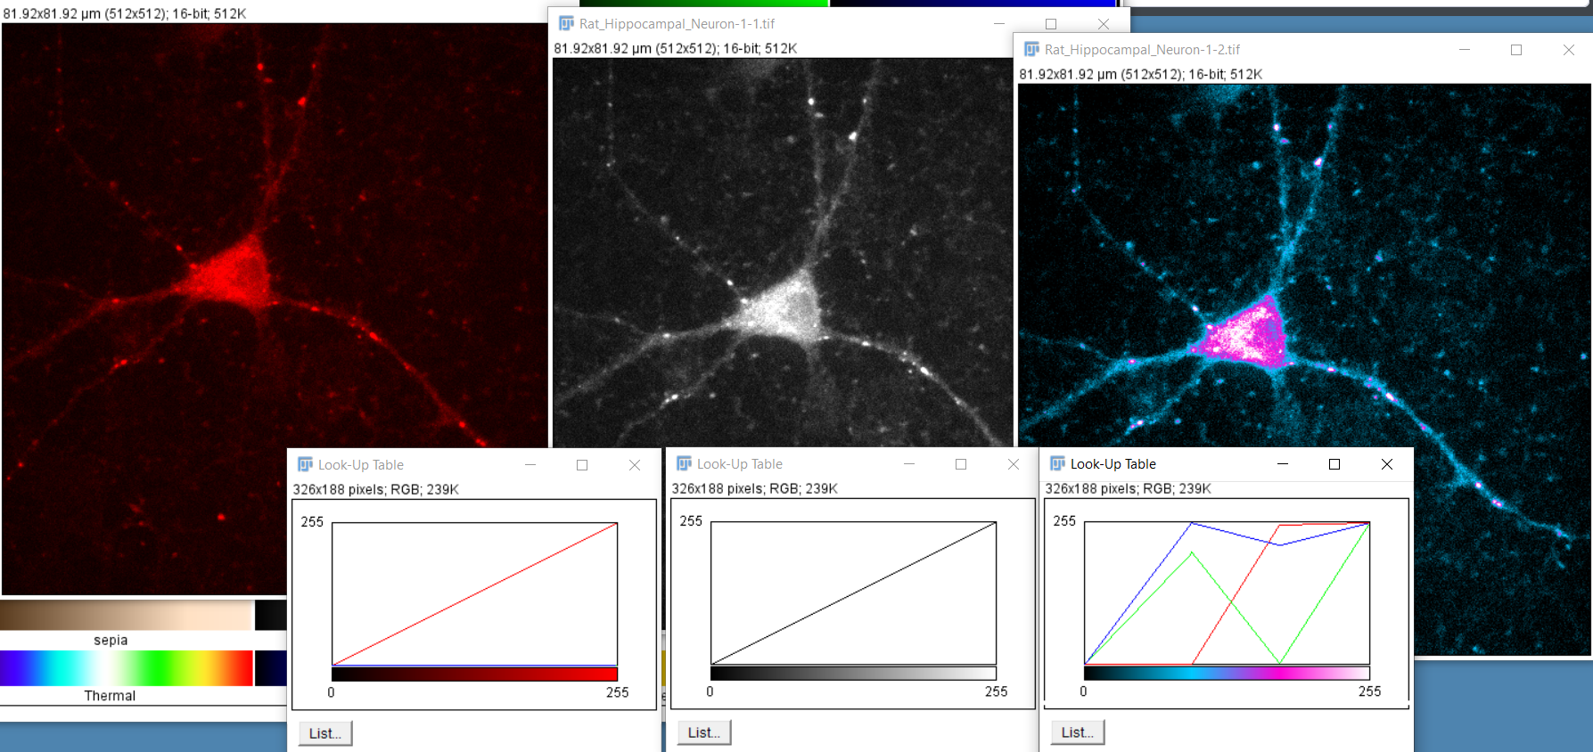
Background 3: Lookup tables (LUTs)

Slide 8
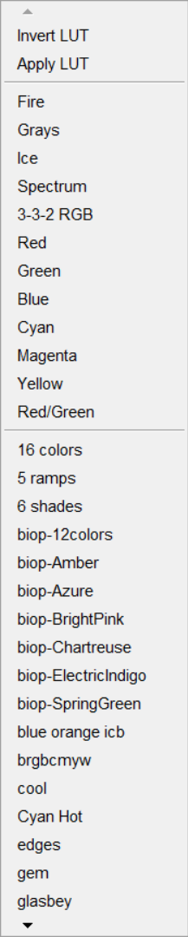
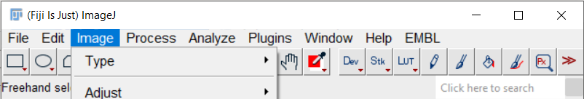
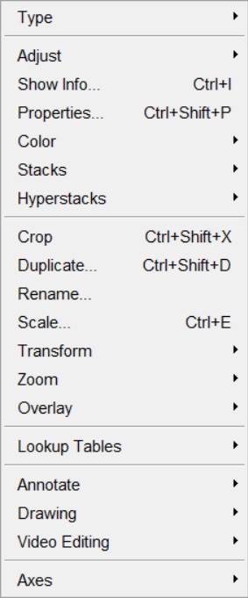
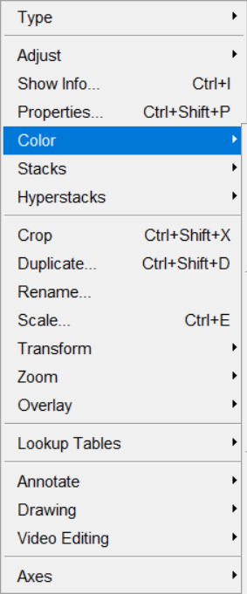
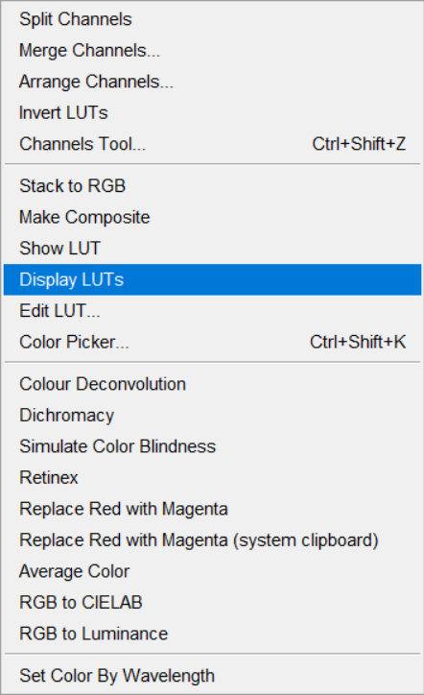
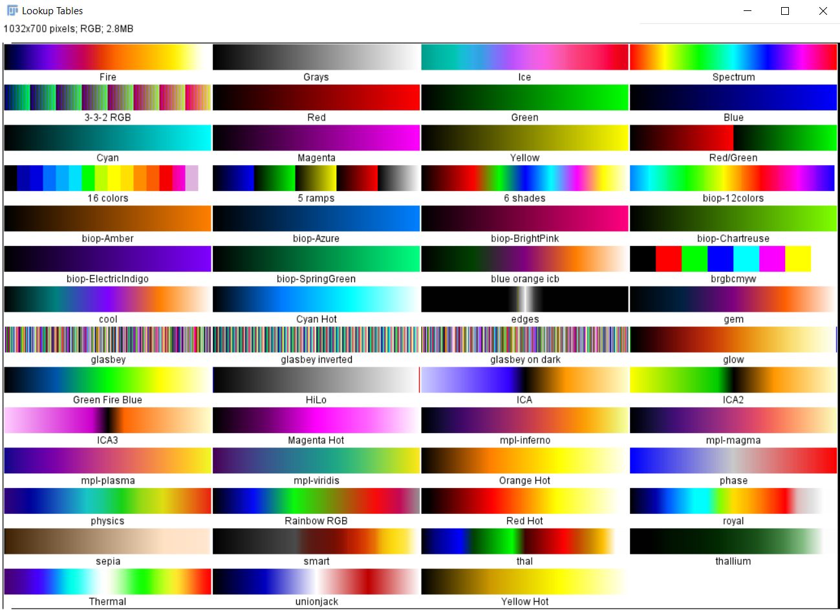
Background 3: Lookup tables (LUTs)
Assign LUT to current image

Slide 9
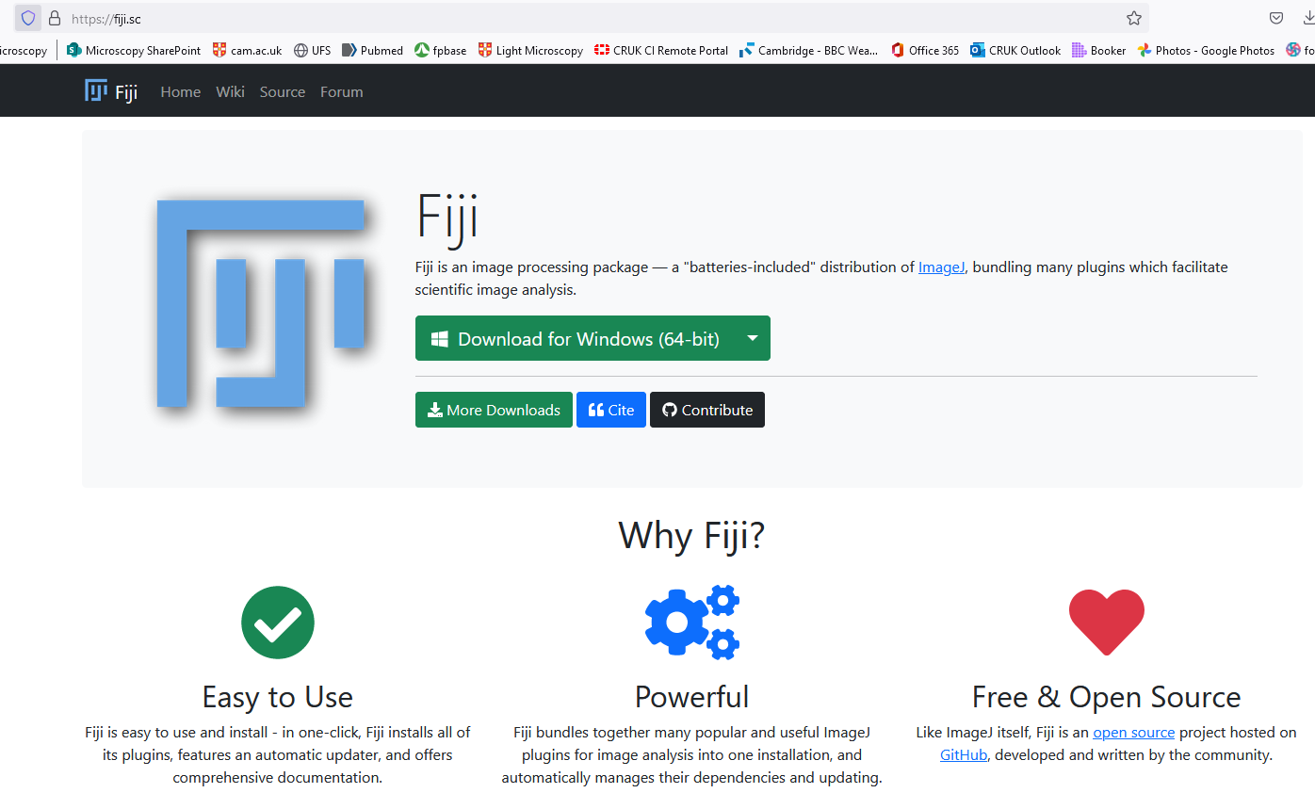
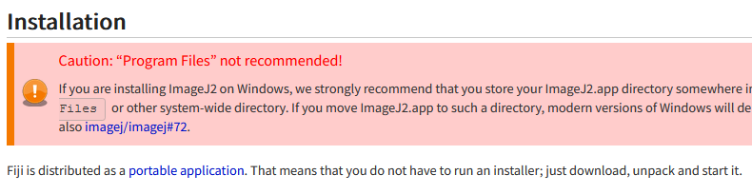
Lesson 0: Installation and startup
A portable application (you can keep it on a remote disk, or even thumbdrive)
Usually not recommended to save it in your C:\Program Files\ for permissions reasons
https://fiji.sc
https://imagej.net/software/fiji/downloads

Slide 10
Lesson 1: Opening an image

Slide 11
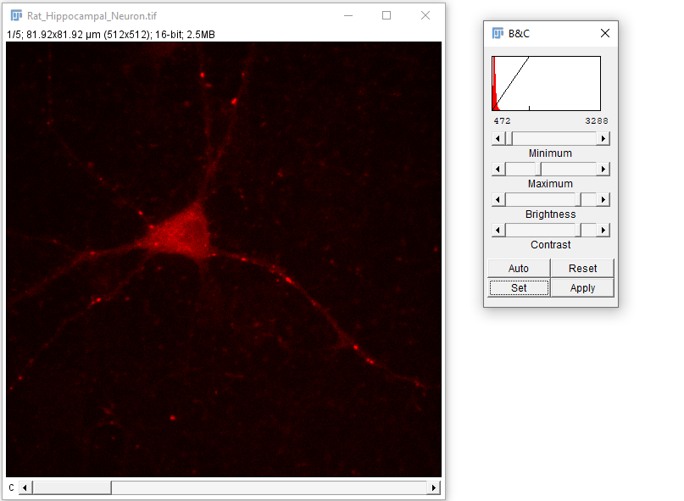
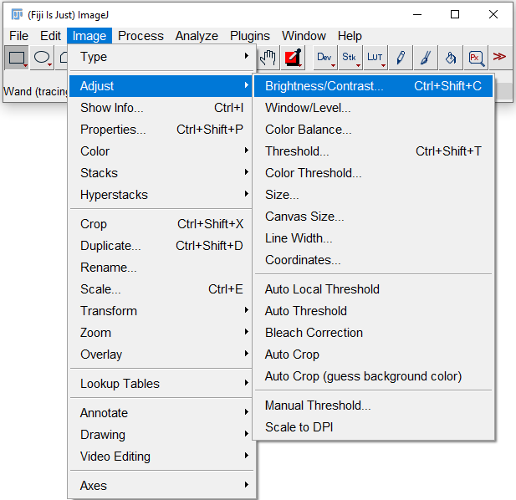
Lesson a: Adjusting the image display

Slide 12
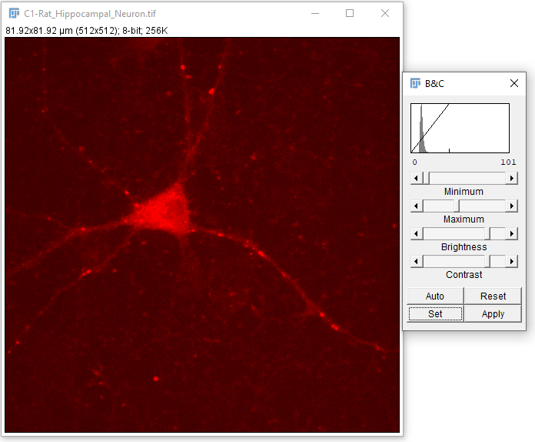
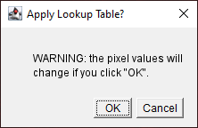
Things that will screw up your pixel values #1:
If you do click this, FIJI will explicitly warn you about what’s about to happen.
Your pixel values will be adjusted to fit the scale that you currently have visible.
!

Slide 13
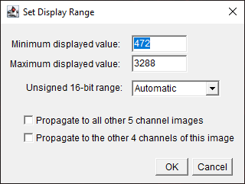
Lesson a: Adjusting the image display

Slide 14
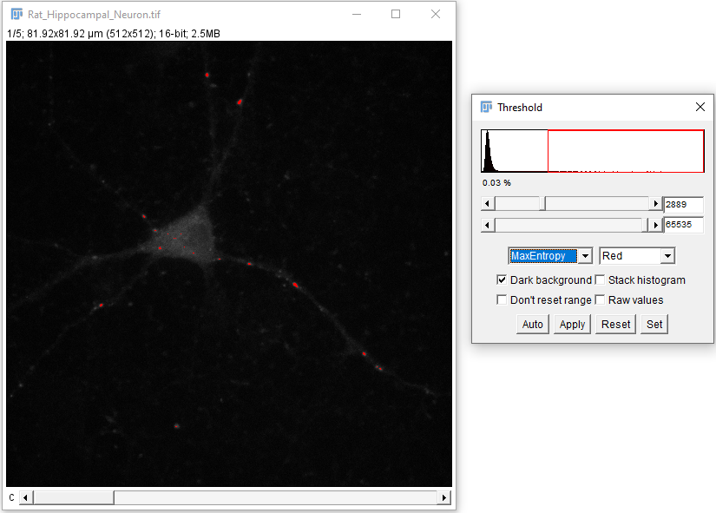
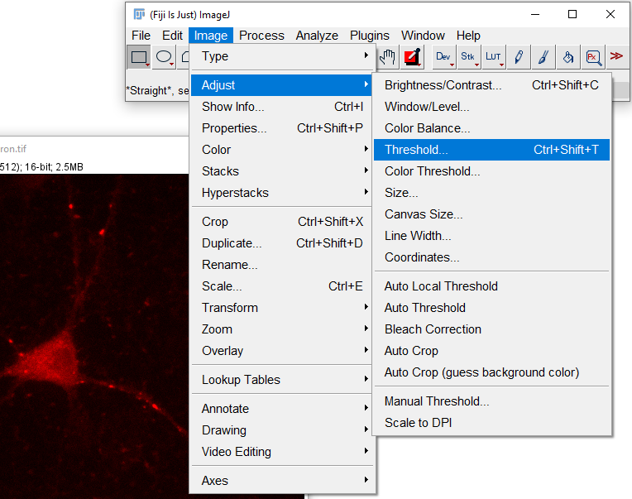
Lesson c: Thresholding

Slide 15
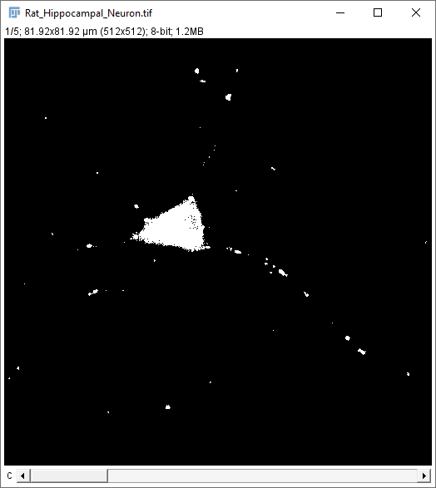
Lesson c: Thresholding
Clicking ‘Apply’ converts the image to a binary image – pixels that were below the threshold become 0, those above it become 255 (max on 8-bit scale).

Slide 16
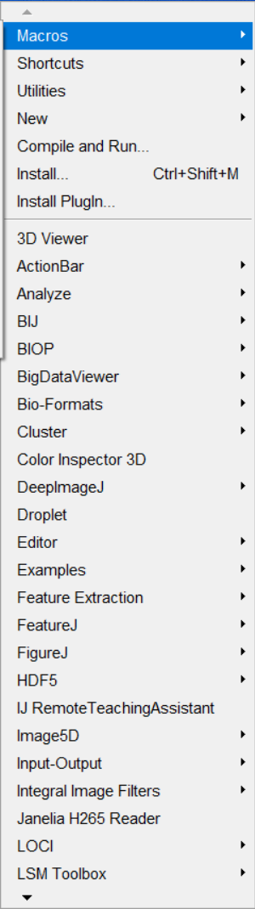
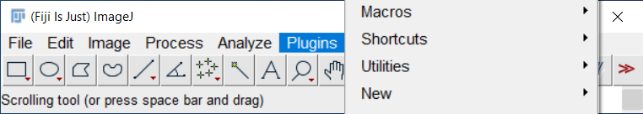
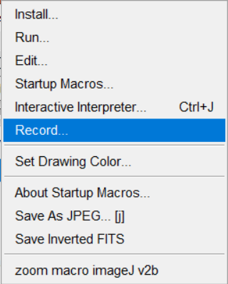
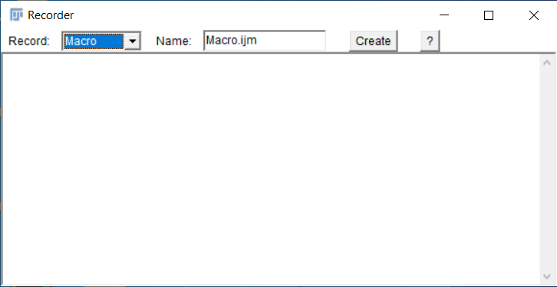
Scripting in FIJI and the Macro Recorder
A premature intro – let’s leave this running in the background and come back to it later.
You’ll see code for the things we click on appear in the recorder window.

Slide 17
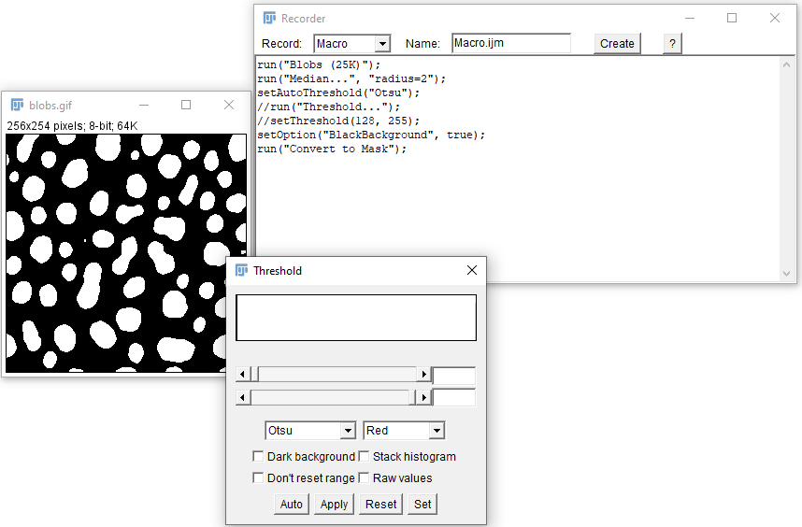
Macro Recorder
This is the raw recording of a simple procedure.
Depending on what you clicked, it may need some modifications to create a useable script.

Slide 18
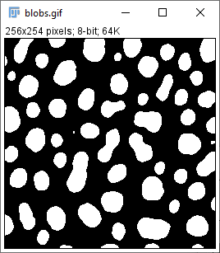
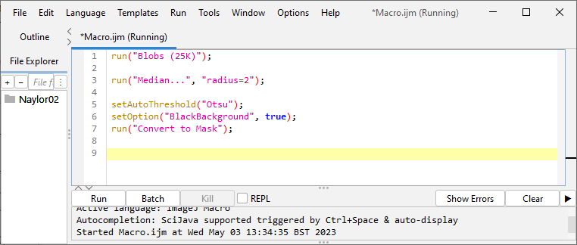
Macro Recorder
A sequence of operations is now reduced to a single click.
We’ll work up this further later on.

Slide 19
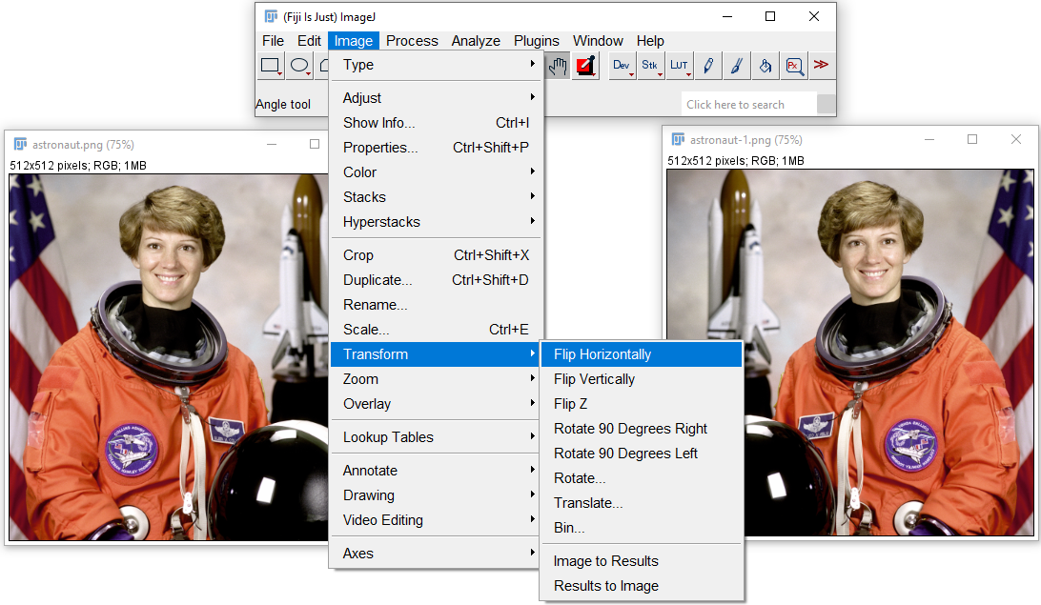
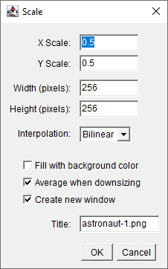
Lesson 2: Transformations (flip, scale, etc.)

Slide 20
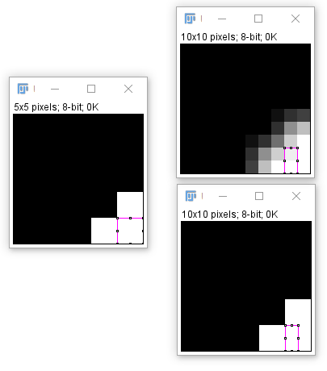
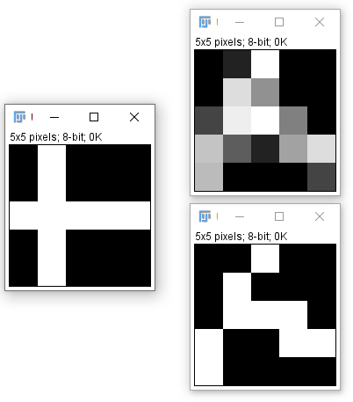
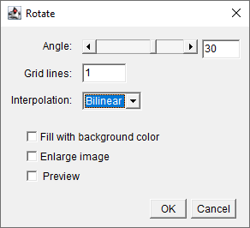
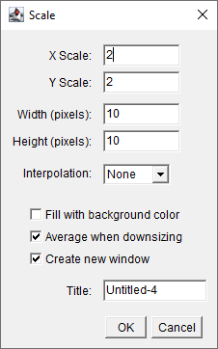
Things that will screw up your pixel values #2:
30° rotation, with and without interpolation
2x scale-up, with interpolation
no interpolation
Perhaps obvious, but scaling images up or down, and rotating them (except by a multiple of 90°) will cause some changes to pixel values. Pay attention to what effect any interpolation has.

Slide 21
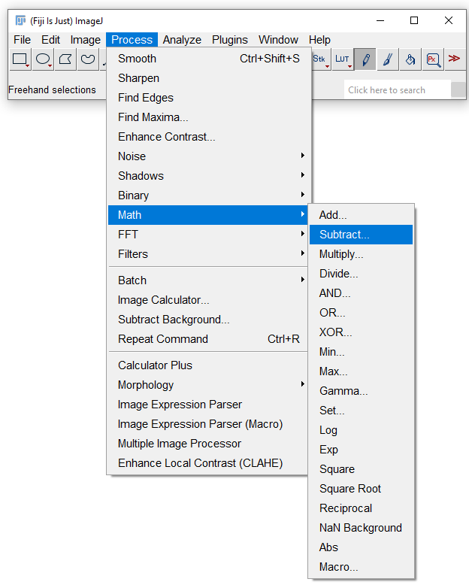
Lesson 3: Process > Math

Slide 22
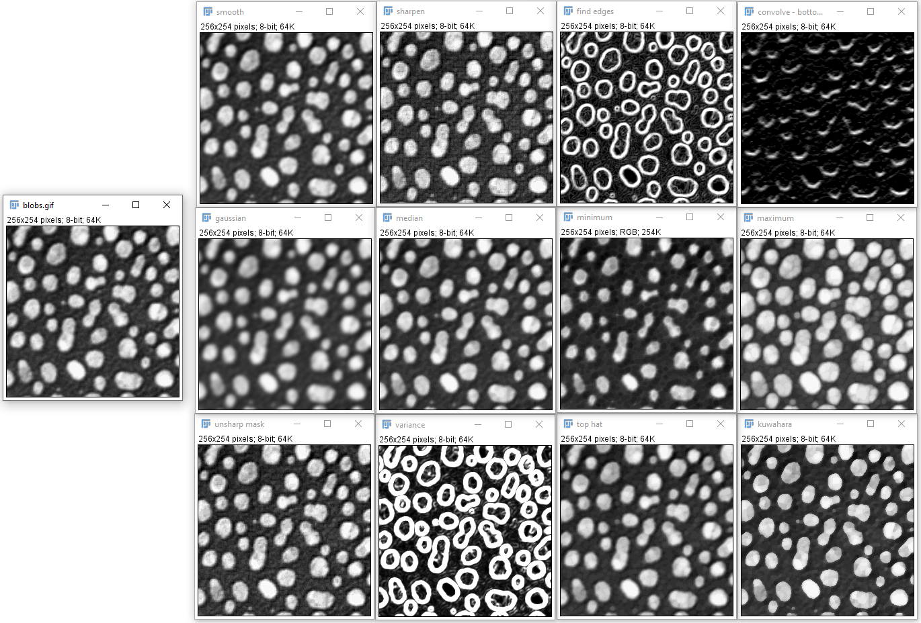
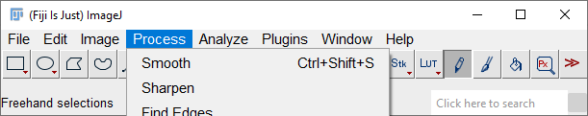
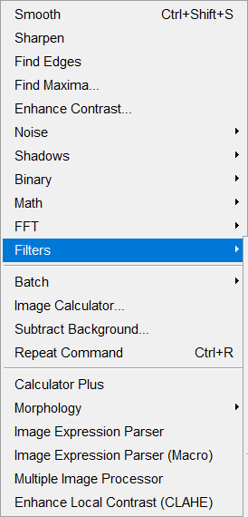
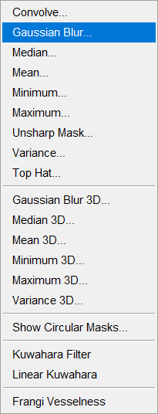
Lesson 4: Process > Filters
Kernel: 1 1 1
0 0 0
-1 -1 -1

Slide 23
Lesson 4: Filtering

Slide 24
Lesson 4: Filtering

Slide 25
Lesson 4: Filtering

Slide 26
Lesson 4: Filtering

Slide 27
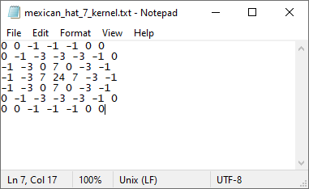
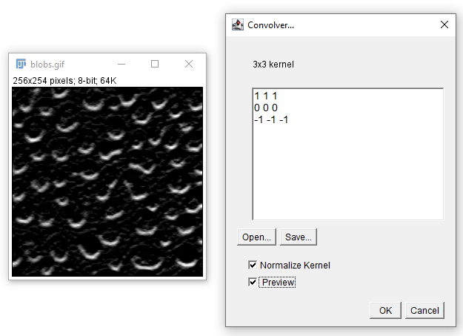
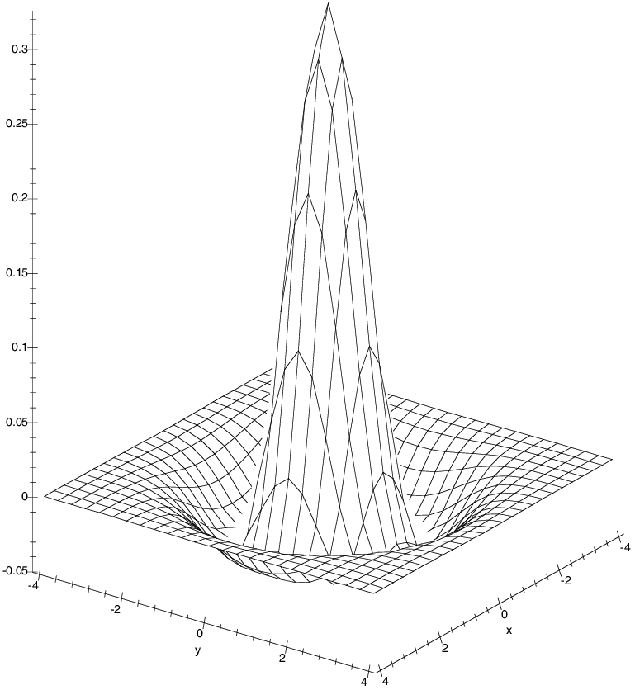
Lesson 4: Filtering

Slide 28
More dimensions: stacks; timelapses, etc.

Slide 29
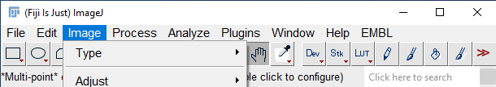
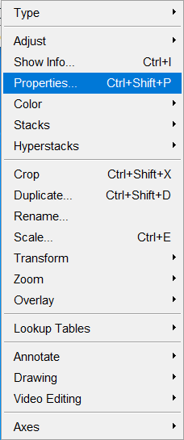
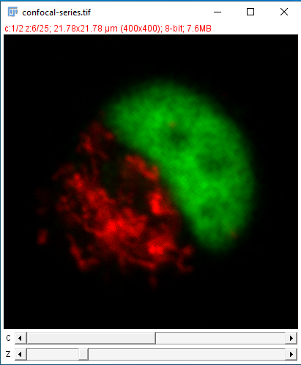
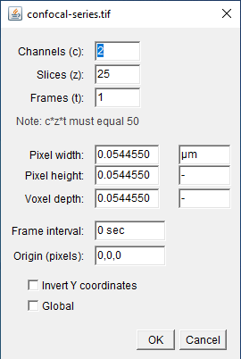
More dimensions: stacks; timelapses, etc.

Slide 30
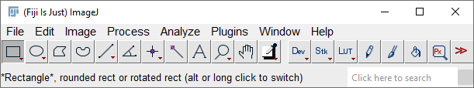
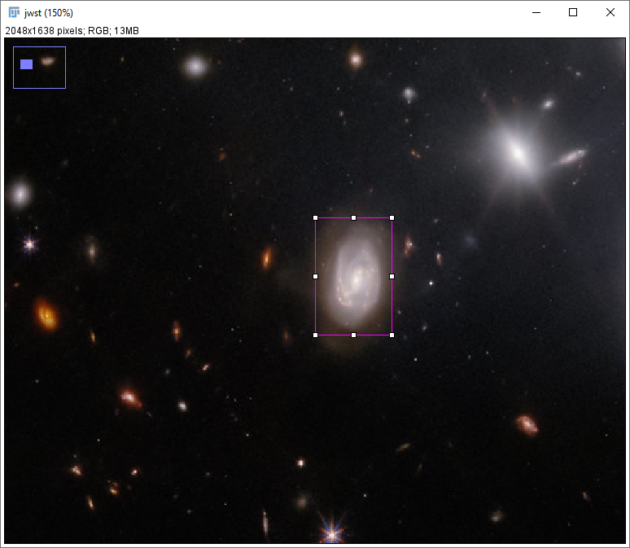
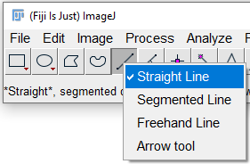

Lesson 5: Selections
Hint: right-click on these buttons for alternative tool; double-click them for options.

Slide 31


Lesson 5: Selections
(the whole image)
Remove selection
Bring back a selection – including from a *different image*
Many tools for manipulating a selection

Slide 32



Lesson 6: ROIs and the ROI Manager
Hint: when doing lots of ROI work, use the Ctrl+t (or just ‘t’) hotkey!

Slide 33



Lesson 7: Measurements

Slide 34
Macros: Putting it together 2
Let’s try to make new recordings and extend our earlier macro:
Open an image
Duplicate it, with a new name
Apply a useful filter
Set a threshold and convert to binary
Save this binary image (so we have a record of the objects we measured)
Run Analyze Particles… to create ROIs from the binary image
Take those ROIs back to the original image, and Measure them to get intensities
Save the results table

Slide 35

Macros: Putting it together 2
Magic #@ lines create dialog box to get files, folders etc
Use + to concatenate strings
Go back to the original image before measuring

Slide 36


Scale bars and other annotations
Adding a scale bar is easy if your image is already calibrated.
But check that the metadata that has come in from the microscope is correct!
If the scale information isn’t there, add it either:
manually by adding the pixel width in
Image > Properties, or,
By using Analyze > Set Scale… and measuring from a known-size object in the image

Slide 37



Scale bars and other annotations

Slide 38

Lesson 9: Overlays in general
These function in much the same way as ‘layers’ in many image-editing programs, allowing you to hold objects above the pixel data itself, non-destructively.
You can then ‘flatten’ them down onto the image when finished, ready to export it.
Interconvertible with ROIs
Scale bars, text boxes, etc can all be managed as overlays

Slide 39
Lesson 12: Using a plugin

Slide 40
Lesson 13: Example application of a plugin

Slide 41
Macro Scripting: Resources
https://github.com/BiAPoL/imagej-macro-cheat-sheet/blob/master/ImageJ_macro_cheatsheet.pdf

Slide 42
Macro Scripting: Resources
https://github.com/BiAPoL/imagej-macro-cheat-sheet/blob/master/ImageJ_macro_cheatsheet.pdf

Slide 43


Macro Recorder to Script
Trying to re-run this straight out of the box caused this error.
Let’s troubleshoot…

Slide 44

Macro Recorder to Script
Don’t need to select the window if it’s the only image open
These were just from clicking different threshold algos, we can get rid
This run(“Close”); line is the problem – when using the GUI, an options window was open which I manually closed – this was logged in the recorder!

Slide 45
Limitations of FIJI: when to use something else
Very large 2D images, e.g. whole slidescans, TMAs (white-light, or fluorescence) – better off in HALO (commercial – see the Histo core) or QuPath (FOSS)
3D visualisation, processing and stitching – often better off in Imaris, or Arivis Vision4D (Microscopy core holds licences for both of these, commercial)
Some modern machine learning packages are not so easy to integrate into a Java-based platform such as FIJI, and so users are pushed elsewhere.

